Slide 1
A toolbox for single unit analysis
HyungGoo Kim
Uchida Lab

Slide 2
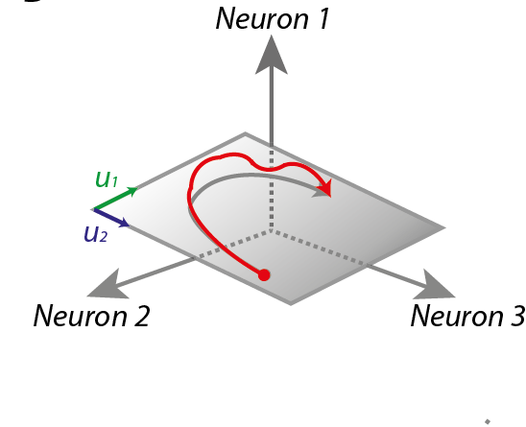
Single unit and Population dynamics
Batch processing of
Single units
Load data
Analyze (e.g., orientation
selectivity index)
Save numbers
Population Data
Population Analysis

Slide 3
Cognitive process of single-unit analysis
Hypothesis (or just do assumption-free experiments)
Repeat until you have N conclusions (e.i., figures)
Plot results by events of interest
Look at the results carefully
Make a quantitatively testable hypothesis
Quantify responses
Population analysis
Prove or disprove the hypothesis by statistical tests
Do modeling if necessary
Present
Write
Fun
IF
If you can look at data fast, flexibly
Examine population easily with stats
Otherwise,
Projects will be delayed
Conclusion can be wrong

Slide 4
Data
0
Continuous signals
1000Hz (1ms bin)
Discrete events
One event per trial (e.g., trial onset, reward onset)
2D array (nTrial X nEvent), values represent event timestamp in milisecond
Multiple events per trial (movement onset, lick onset)
Timestamp in millisecond (e.g., lick = [1942 1949 2029 …. ];

Slide 5
PSTH (peri-stimulus time histogram)
plot_timecourse(data_type, resp, trigger, trial_start, trial_end, grp, varargin)
Type-free
Continuous or timestamp as a function of time
Continuous or timestamp as a function of distance
Flexible
Constant window or variable window
Rigorous
N
Stats
Easy to save, load, plot

Slide 6
Population analysis
Extract numbers from PSTHs
Within-session analysis (across trials)
Across-session analysis (using session-average, across session)
Visualization accompanies stats
Rigorous
N, OL

Slide 7
Disclaimer
Bugs will happen; suspect the results!

